Slide 1
The review will begin shortly.
Please remember to leave feedback before you go.
The link will be at the end of the review and in the chat.
If you have a question, click on the “raise hand” button located under the participants tab.

Slide 2
Exam 3 Review
CIS4301

Slide 3
Exam Topics
Types of Questions
Foreign Keys
Functions
Triggers
Java
Multiple choice
True False
Fill-in-the-blank
Essay-Style

Slide 4
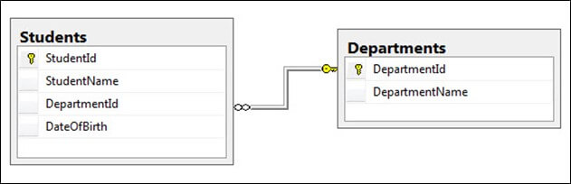
What are foreign keys?
Foreign keys are attributes within a table that are “borrowed” from another table. These attributes connect tables together.

Slide 5
Foreign Key Violations
Insert/Update new values not already in the database
Update/Delete values might conflict with old values in other tables

Slide 6
INSERT
INSERT INTO tableName (attributeName1, attributeName2) VALUES (attributeVal1, attributeVal2);

Slide 7
UPDATE
UPDATE tableName
SET attributeName = newVal
WHERE attribute1 = attribite1 AND attribite2 = attribite2;

Slide 8
DELETE
DELETE FROM tableName
WHERE attribute1 = value;

Slide 9
Function Template
CREATE FUNCTION name ( parameterName type, …)
RETURNS returnType
BEGIN
Stuff
END;

Slide 10
Practice Problem Directions
You will have 5 minutes to complete the problem before the answer will be revealed.
Schema:
accountHolder(name: VARCHAR(255), ssn: INTEGER, accountID: INTEGER)
account(accountID: INTEGER, accountType: VARCHAR(255), amount: FLOAT)
Account types are “savings” or “checking.” For the purpose of these examples, a savings account doesn't allow any transfers from one account to another. A checking account allows transfers.
Notes:
Please indicate when you have completed setup with the green check box. If you do not want to participate, then answer with the green check anyway so that I will know to continue.

Slide 11
Create a function, called Deposit, that allows a user to deposit money into their account. Pass in only the account ID of the user and the amount of money deposited.
CREATE FUNCTION Deposit(userID INTEGER, money FLOAT)
RETURNS VARCHAR(255)
BEGIN
UPDATE account SET amount = amount + money WHERE accountID = userID AND amount = amount AND accountType = "savings";
RETURN CONCAT('Added $',money,' to accountID ‘, userID);
END;

Slide 12
Trigger Template
CREATE TRIGGER name
[after/before] [insert/update/delete] ON tableName
FOR EACH ROW
BEGIN
stuff
END;

Slide 13
Create a trigger, called WithdrawCheck, that checks to see if an update on a user’s account does not make the new amount of money less than zero / negative.
CREATE TRIGGER WithdrawCheck
AFTER UPDATE ON account
FOR EACH ROW
BEGIN
IF NEW.amount < 0 THEN
UPDATE account SET amount = 0 WHERE accountID = accountID AND accountType = accountType AND amount = amount;
END IF;
END;

Slide 14
Stuff to Know for the Exam
Know how to open a connection to a database
Know how to use prepared statements
Know how to write Java code to print all the tables or attributes within a table.
Know how to edit the values within a table in Java.

Slide 15
Questions So Far?
Notes:
How is everyone doing?
Do you want more SQL problems, or are you all good with that?
There was a request to review HW6, but I believe the answer key was modified to include more info. Do you want me to still go over that?

Slide 16
Good Luck!

Slide 17
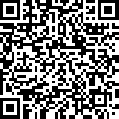
Feedback
https://forms.gle/gEMbDQcpEUc5CdKJ7

